Slide 1
ME504 Deep learning Project
Siddharth Goyal (2022MEB1346)
Spandan Prasad Seth (2022MEB1348)

Slide 2
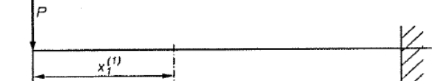
Problem Statement
Consider a beam configuration with circular holes with a single point load of
known magnitude at the top extream end of the beam. Generate the random topologies of the
beam by altering the number, position, and size of the holes in a random manner. Use CNN to predict the displacement field. Then, explore the use of ensemble and bootstrap
techniques to improve the predictions.

Slide 3
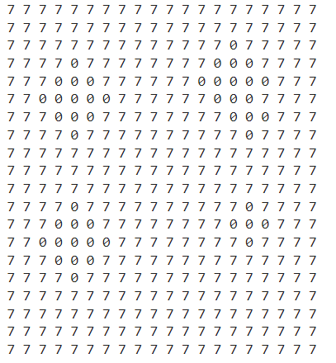
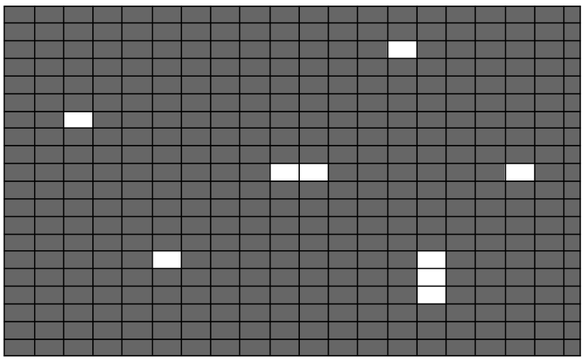
Generating Topology

Slide 4
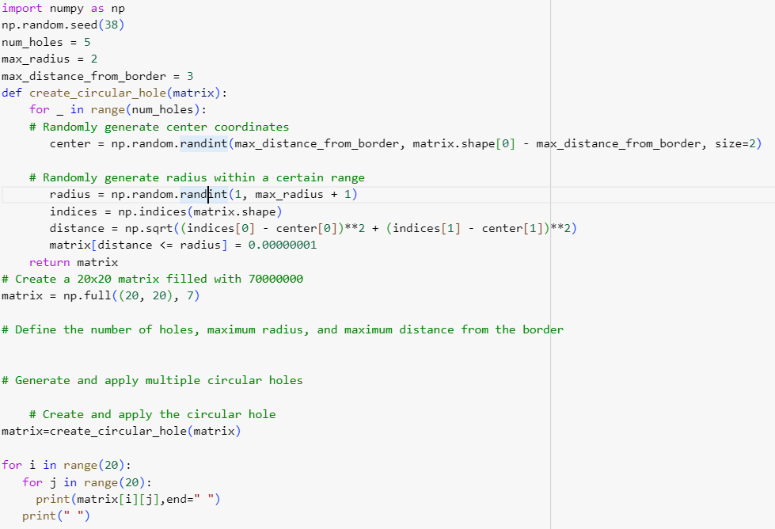
Code for Topology

Slide 5
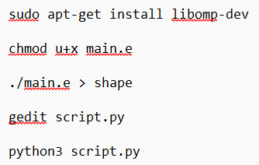
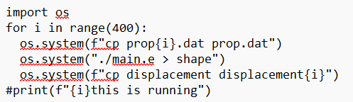
Data Generation
We were given prop.dat file, then we generated 500 property files.
We then using linux commands, making the use of load and property files, generated 500 displacement files.

Slide 6
Data
We have 500 displacement files with each file having displacement rows of 1681 nodes(41*41) and 3 columns, i.e. displacement in x.y and z direction.
We have one load file and In our case it contains load only in one( y) direction, therefore dimensions for this becomes 1*4.
We have 400 prop files that contains around 361 to 400 rows, showing properties of 400 elements, which contains young’s modulus of each node
Now we need to train a model

Slide 7
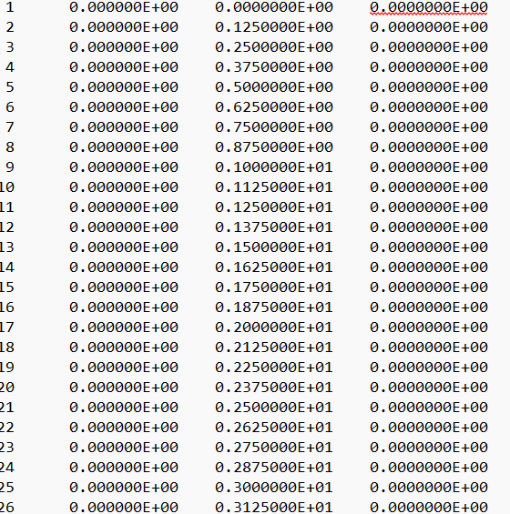
Displacement file specimen

Slide 8
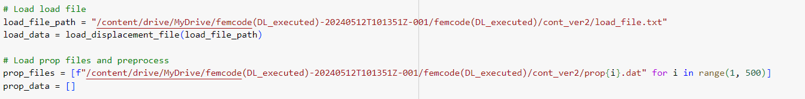
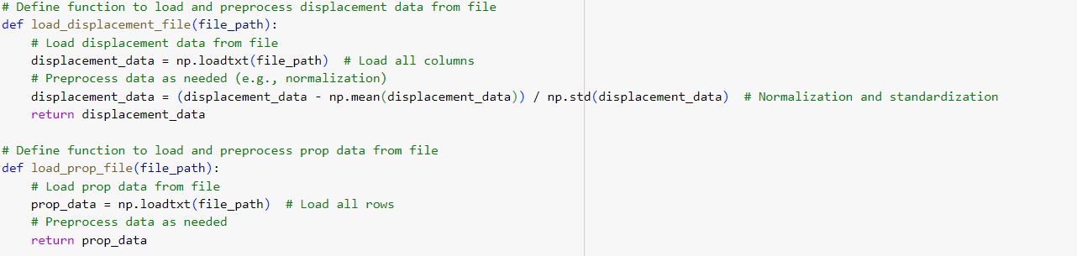
Loading Data on Model

Slide 9
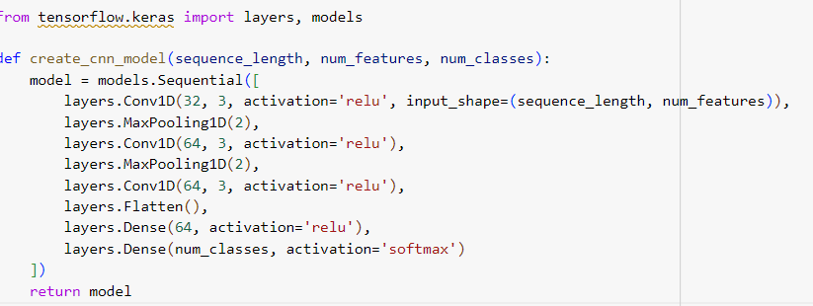
Core model

Slide 10
Error we found
ValueError: invalid column index 1 at row 1 with 1 columns
There was inconsistency in the prop files data that we generated.
The error message suggests that there's a change in the number of columns detected between rows.

Slide 11
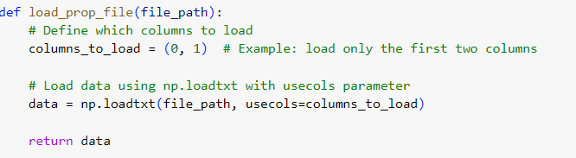
How we tried to correct it?
A solution we think of was “usecols”:
Replacing (0,1) with the indices of the columns from the file, should had prevent the error as we thought,

Slide 12
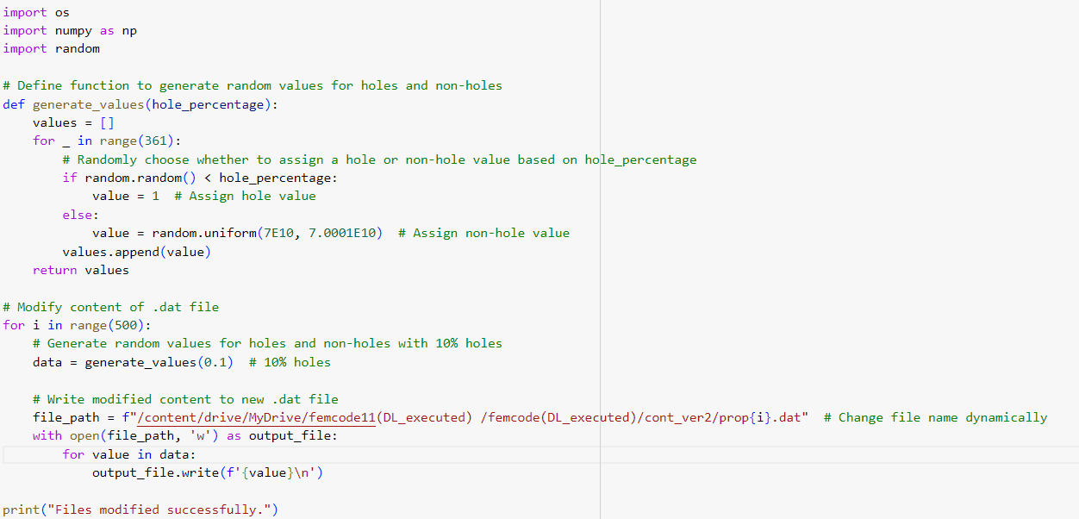
Solutions:
We tried to change the code for prop file generation, and modify the files but were unable to get rid of that error while training the model.

Slide 13
Thank you

